Slide 1
Peasants, Trade, & Cities
Block 1

Slide 2
Vocabulary pgs. 232-235
Carruca
Serf
Patrician
Manor
Bourgeoisie
Medieval
Technology
Crucial

Slide 3
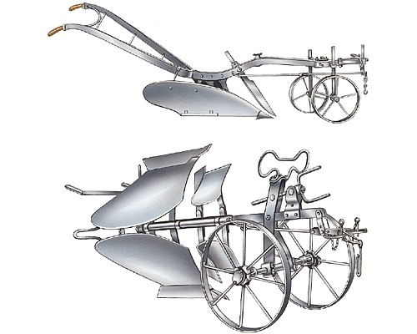
Carruca
A heavy, wheeled plow with an iron plowshare.

Slide 4
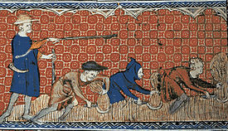
Serf
Peasants legally bound to the land.

Slide 5
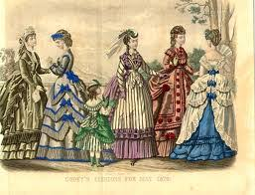
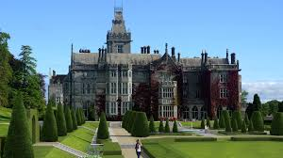
Bourgeoisie
Manor
The middle class, including merchants, industrialists, and professional people
An agricultural estate that a lord ran and peasants worked.

Slide 6
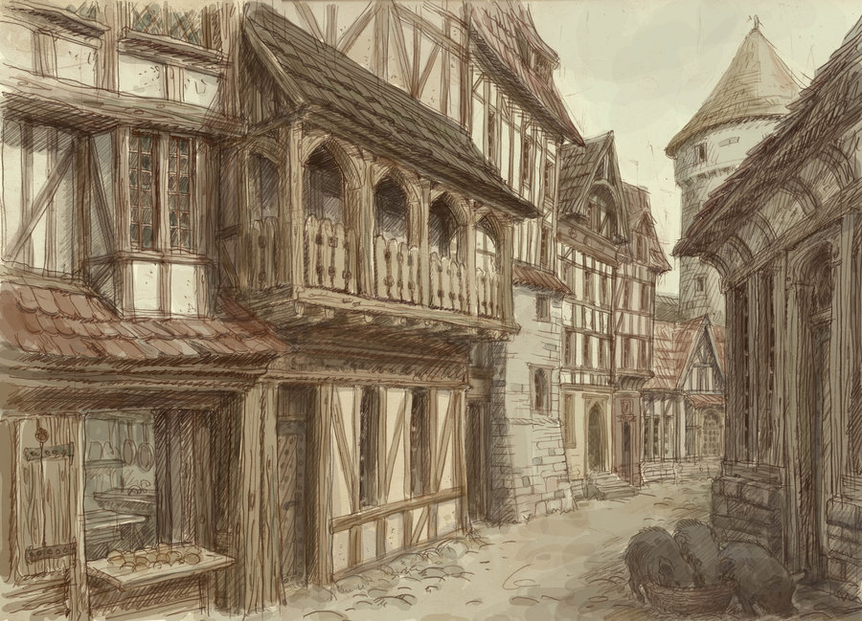
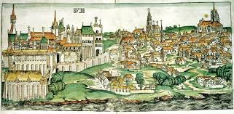
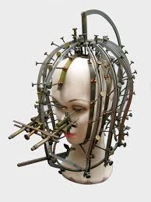
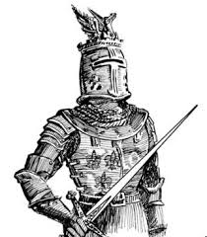
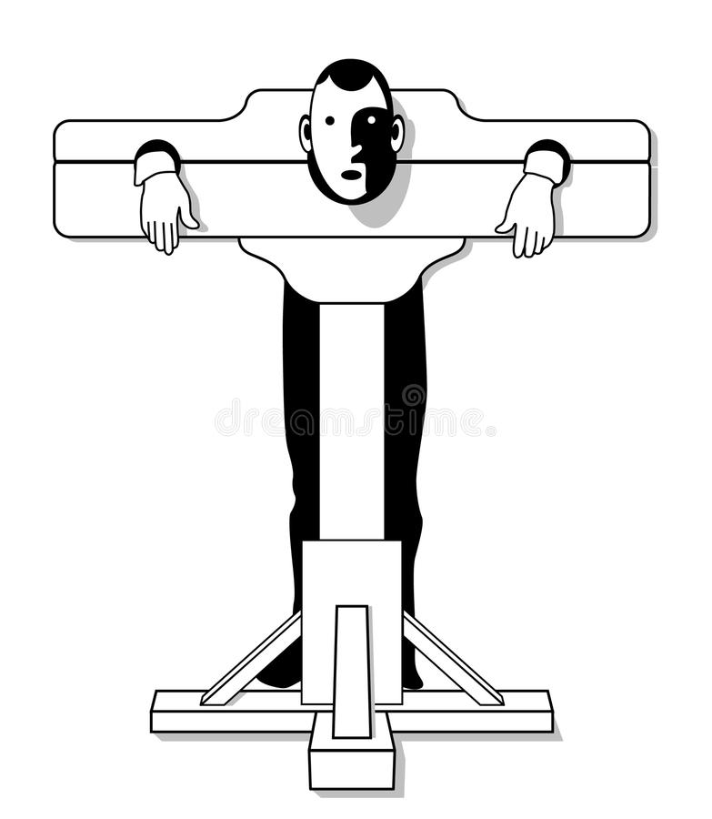
Medieval – relating to
the Middle Ages

Slide 7
Bellwork: Block 1
What were the main groups of people in the High Middle Ages in Europe? How was society organized?

Slide 8
How did new farming methods benefit Europe in the Middle Ages?
Changes in climate, agricultural technology, and decreased warfare led to a population explosion between 1000 and 1300.
Labor-saving devices, like the carruca, allowed the agricultural industry to supply food to the increased population.
Farmers at this time also started using a three-field crop rotation that allowed for better use of the land.

Slide 9
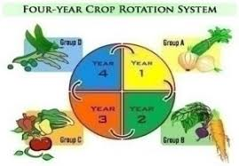
What factors led to population growth in the High Middle Ages?
A more peaceful Europe
Increased food production
New technology
Improved crop rotation

Slide 10
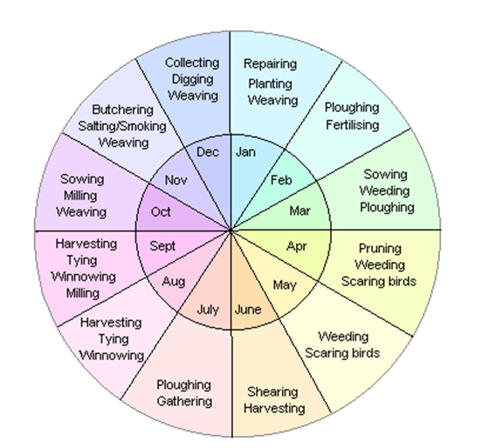
What was life like for nobles and peasants under the economic system of manorialism?
Landholding nobles owned large agricultural estates, or manors, which made their leisurely lifestyle possible.
Manors were worked by peasants and serfs who did so in exchange for protection and the chance to own a small piece of land.
The manorial system was similar to feudalism, but it lacked the political and military implications that underpinned feudalism.
Peasants lived in simple thatched cottages and performed a variety of tasks, determined by the seasons of the year.

Slide 11
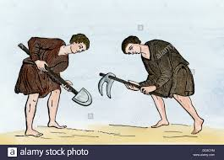
How were serfs legally bound to the land?
Serf’s worked the lord’s land and gave a percentage to him
Paid Rent
Were subject to the lord’s laws

Slide 12
What spurred the growth of cities in the Middle Ages?
The revival of trade in medieval Europe led directly to a growth of cities in the eleventh and twelfth centuries.
Merchants and craftspeople settled in old Roman cities as well as founded new ones, especially in northern Europe.
The merchant and artisan class of these new cities later came to be called burghers, or bourgeoisie.
Over time, cities fell less under the control of the local lord and were governed instead by a system designed to keep patricians in power.

Slide 13
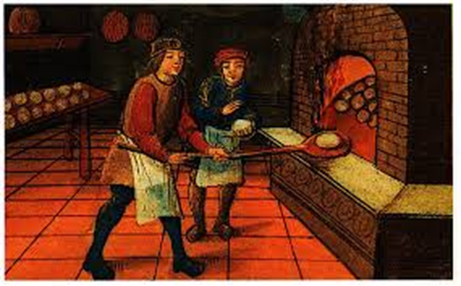
What were guilds and what did they do?
Guilds were organizations of people who all worked in the same craft. Guilds set standards for the quality of goods produced and determined who could enter their trades.

Slide 14
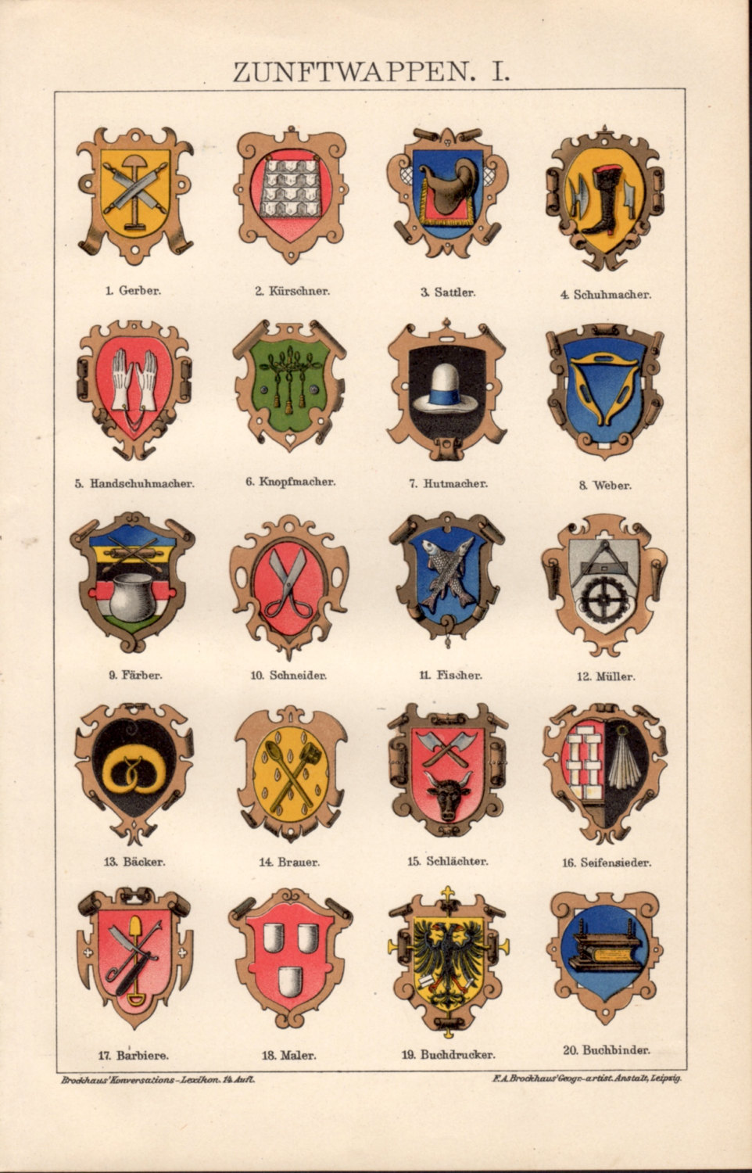
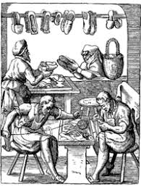
What role did guilds play in the economic life of towns and cities?
Guilds set quality standards
Fixed Prices
Controlled the number of people
entering a trade

Slide 15
Medieval Trade Routes
Are there more trade routes on water or on land?
Why do you think this was the case?

Slide 16
What freedoms did people in cities have? How did they get them?
People had the right to buy and sell property
Freedom from military service
Written law guaranteeing their freedom
An escaped serf had the right to become free after having lived there in a town for more than a year
People gained these freedoms from buying them from lords and kings.

Slide 17
Facts about Medieval city planning
Because of the need to keep medieval cities small and enclosed, the only open space in most cities or towns was the market square and the area near the church or cathedral. Main streets came out of the market center like the spokes of wheel and led to a small number of gates in the walls around the city.
In medieval towns, homes were built close together and were framed with heavy timbers. Walls were usually just woven reeds mixed with clay or plaster. Roofs were often thatched, and floors were lined with straw. Fireplaces had chimneys, and fire caused by sparks landing on the roof was a significant danger.
The most important structures in medieval towns were cathedrals and halls for guilds. Some of the cathedrals, such as the one in Chartres, France, are still standing today.

Slide 18
Do you think women had more freedom in cities or on manor? Why? Don’t answer on the back…cause DUH! You have no room. Oops!

