Slide 1



WELCOME BACK!
AUGUST
GENERAL MEETING
2019-2020

Slide 2


Minute to Arrive
Sarah Encinas
Member At Large

Slide 3
OUR MISSION
Augustina Mills
President

Slide 4


The Junior League of Tucson, Inc. is an organization of women committed to promoting voluntarism, developing the potential of women and improving the community through effective action and leadership of trained volunteers. Its purpose is exclusively educational and charitable.

Slide 5
PLANS & GOALS FOR 2019-2020

Slide 6
Annual Plan
Review Annual Plan - handouts

Slide 7
Evaluation and Development Plans
Property
Communications
Fund Development

Slide 8
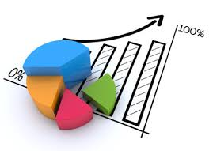
Key Performance Indicators (KPIs)
A Key Performance Indicator (KPI) is a measurable value that demonstrates how effectively an organization is achieving key objectives. Organizations use KPIs to evaluate their success at reaching targets.
  EX: Community Impact hours, # of attendees per event, member participation & satisfaction, etc.

Slide 9
Evaluation and Development Plans
X% TOTAL VOLUNTEER HOURS OFFERED ARE IN THE JLT’S ISSUE AREA

Slide 10
Member Training and Development
Participant Satisfaction
Participant Satisfaction
% PARTICIPATION IN AT LEAST ONE ENGAGEMENT EVENT
ACTIVE MEMBERS | %
SUSTAINING MEMBERS | %
NEW MEMBERS | %
Participant Satisfaction

Slide 11
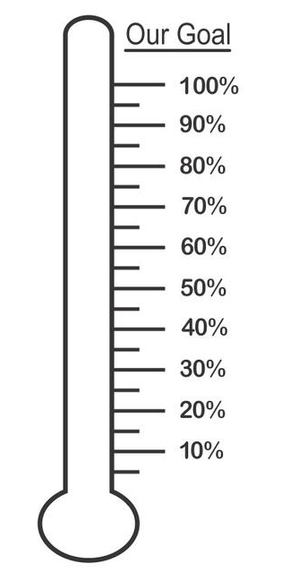
Annual Plan
JL Legacy Income
$$ SPONSORSHIPS
$$ GRANTS
ACCOUNT BALANCES
GENERAL FUND | $
COMMUNITY | $
PROPERTY | $
PROPERTY RESERVE | $
PREVIOUS MONTH
INCOME | $
EXPENSE | $

Slide 12
GUEST SPEAKER

Slide 13
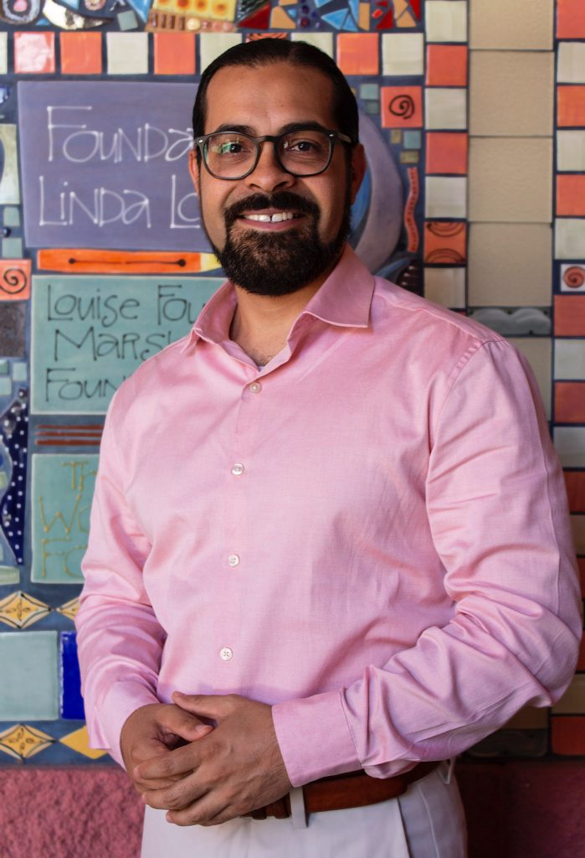

LUIS A. PERALES, M.S.
CEO of Institute for Transformative Education – Changemaker High School
Notes:
Luis Alberto Perales, M.S., is a native son of the Rio Grande Valley of South Texas. A transplant to Tucson, AZ and the Sonoran Desert, Luis has spent two decades in the Old Pueblo. He is the official Spokesman for the K20 Changemaker Campus, CEO for the Institute for Transformative Education, and lead consultant for ZenCons Transformational Consulting. For the past twenty years he has directed his energies to the support, development, and transformation of people, places and institutions. His expertise has led him to train individuals, groups, and organizations wanting to develop their innovative mindset, increase their reach, and maximize their impact. Luis lives with his wife, 15-year-old son, and two 11-year-old twin sons in Tucson.

Slide 14
GRACIAS, LUIS!
Contact Luis at:
lperales@changemakerhighschool.org

Slide 15
LEAGUE UPDATES

Slide 16
Diversity & Inclusion Ad-Hoc
Kelsey Brown
D&I Ad-Hoc Chair

Slide 17


D&I AD-HOC BENEFITS
In our League, we aim at ensuring that all members feel a sense of belonging, commitment, motivation, and pride.
Our ongoing diversity and inclusion efforts attract social and financial support.
Diversity matters to our members, our community and our peer organizations.

Slide 18
D&I AD-HOC COMMITTEE
Who is behind the scenes?

Slide 19
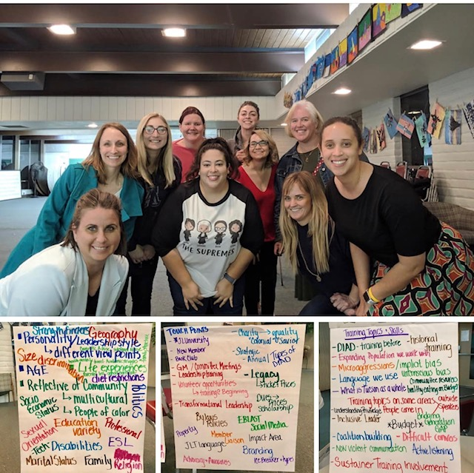
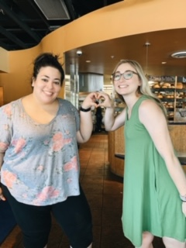
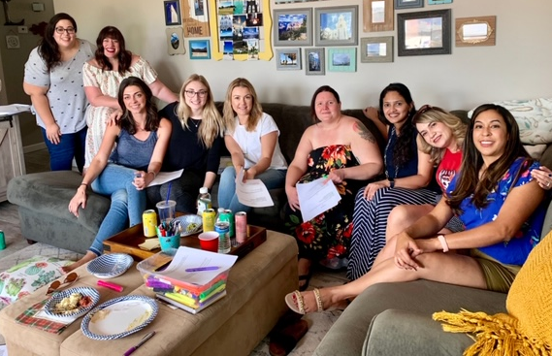
D&I AD-HOC UPDATES
What are we currently working on?
We are hosting D&I Trainings for JLT members who are currently in a Leadership role
AJLI will be issuing a survey this Fall, be on the lookout for it
D&I dedicated budget
We are creating SMART GOALS / ideas of what we’d like to see from each of the JLT committees

Slide 20
D&I AD-HOC INFORMATION
Why are we working on this?
  To align with AJLI!
  For the good of the community, the wellbeing of our society, the strength of our relationships, etc.
    Join in the conversation in the members-only Diversity & Inclusion Facebook Group.
When will this be implemented?
  JLT has made a commitment to working on a 5 year plan.
  Stay tuned and keep your ears open for more D&I initiatives to come throughout the year!

Slide 21
BYLAWS & POLICIES AD-HOC
Monica Akyol
Bylaws & Policies Ad-Hoc Chair

Slide 22
COMMUNITY IMPACT COUNCIL
Community Impact | Public Awareness/Advocacy | Community Engagement
Shauna McGlamery
Community Impact VP

Slide 23

Our current Community Impact Issue Area:
Helping Children and Youth to arrive at school Academically and Socially ready to learn.

Slide 24
Community Impact Council Committees
Community Impact Committee
Chair: Elyse Marshall
Goal: Host events in the community relevant to our issue area
Examples: Kids in the Kitchen, College Application Readiness events, etc.
Community Engagement
Committee
Chair: Lillie Nefawni
Goal: Provide volunteer support for local organizations relevant to our issue area.
Build long-term relationships with community partners.
Awareness & Advocacy
Committee
Chair: Kim Body
Goal: Spread awareness within our membership about city, state, and national issues related to our issue area, and advocate for our issue area in the community.

Slide 25
How do you get involved?
Check Digital Cheetah
for all the amazing
Community Impact volunteer opportunities!

Slide 26
SPONSORSHIP
Jeanne Sharp
Sponsorship Chair

Slide 27
JL LEGACY
Melissa Wolin
JL Legacy Chair

Slide 28

JL LEGACY PRESENTS:
“It’s a Small World”
February 29, 2020
St Philips Plaza
6pm-10pm

Slide 29
MEMBER RECOGNITION
Elizabeth Slater
Member Development Chair

Slide 30
MEMBER ENGAGEMENT
Jocelyn Cummins
Member Engagement Chair

Slide 31
THANK YOU FOR COMING TONIGHT!
SEPTEMBER IN-HOME MEETINGS WEEK OF
9/9 - 9/13…
DATES & LOCATIONS TBD

