Slide 1
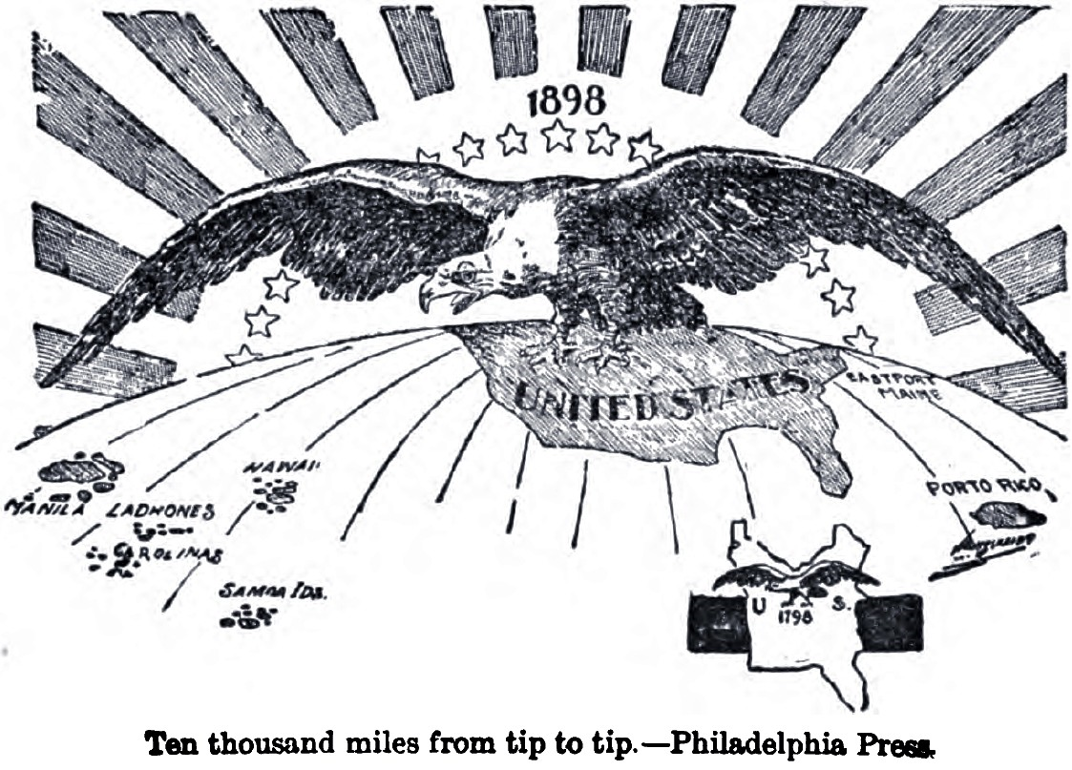
Progressive Foreign Policies

Slide 2
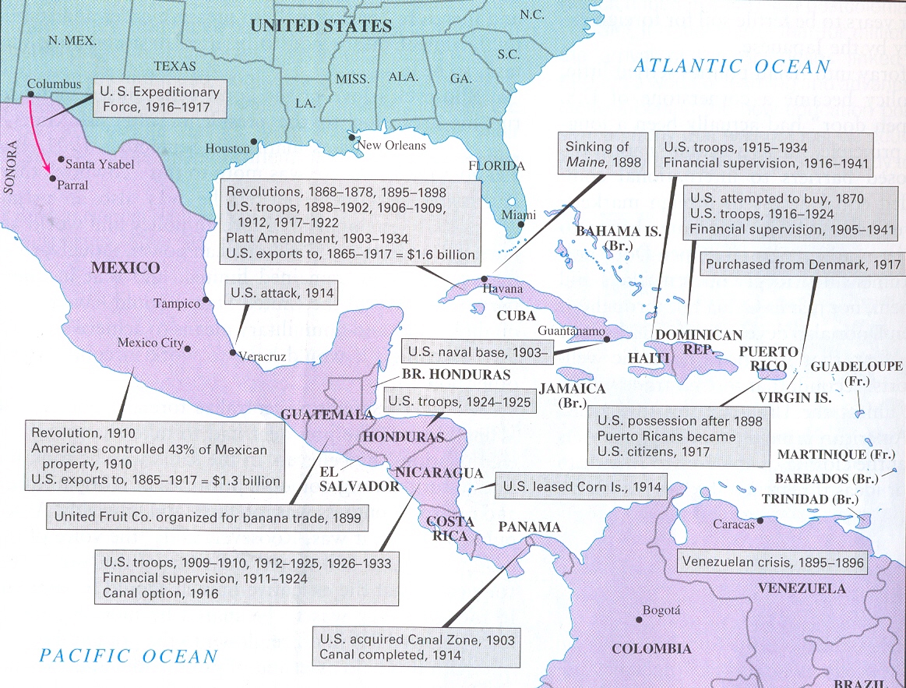
Effects of the Spanish-American War on Latin America
Following the Spanish-American War, the U.S. became more involved in the Caribbean and Latin America.

Slide 3
Introduction to Progressive Foreign Policy
The period following the Spanish American War (1900) until World War I (1918) is often referred to as The Progressive Era.
Progressivism: Effort to reform the U.S. and preserve its democratic values.
Confronted the problems caused by industrialization and urbanization.

Slide 4
Introduction to Progressive Foreign Policy
The Progressive Era was also characterized by a desire to extend those same democratic values into countries within the U.S. “sphere of influence.”
This idea of decreasing European influence while increasing U.S. involvement in political/economic affairs will lead to three different foreign policies during the era:
Big Stick Diplomacy (Roosevelt)
Dollar Diplomacy (Taft)
Moral Diplomacy (Wilson)
To learn more about the goals and implementation of these policies, read pgs. 133-142 & complete the wkst.

Slide 5
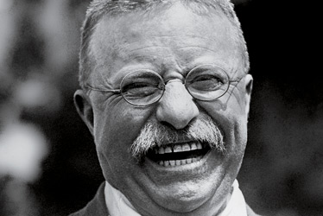
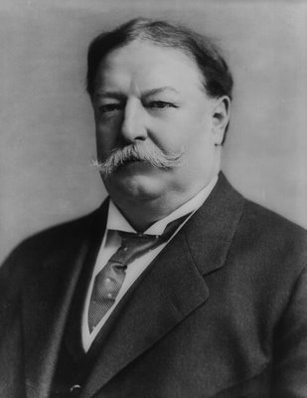
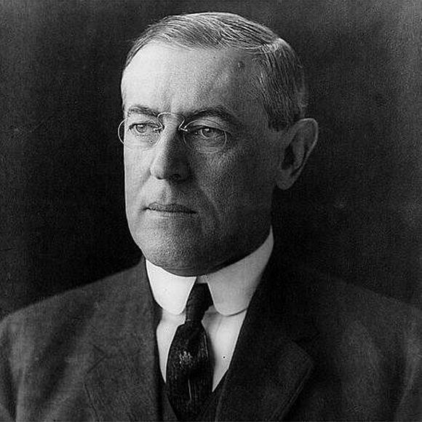
Progressive Presidents Roosevelt, Taft & Wilson
Taft: 1908-1912
Wilson: 1912-1921
TR: 1901-1908

Slide 6
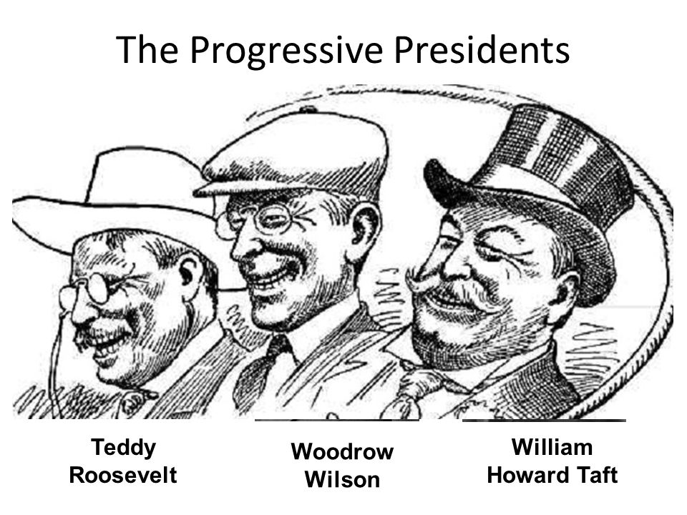
BELLWORK: 9/30
Which expansionist philosophies influenced the foreign policies of the period?
THINKER: How are the foreign policies of TR, Taft, and Wilson similar? Different?

Slide 7
Progressive Presidents Roosevelt, Taft & Wilson
Taft: 1908-1912
Wilson: 1912-1921
TR: 1901-1908

Slide 8
Theodore Roosevelt FUN FACTS!
Nickname: “TR”, “Teddy”, “The Bull Moose”
Personality: Extremely energetic, great speaker
While boxing in the White House with heavyweight John Sullivan, Roosevelt received a blow to his face that left him blind in his left eye. (kept secret for several years)
Mad House: Roosevelt had 6 children, horses, dogs, snakes, cats, a badger, & guinea pigs running around the White House.
A typical TR breakfast included giant mugs of coffee, a package of bacon and 12 eggs!

Slide 9
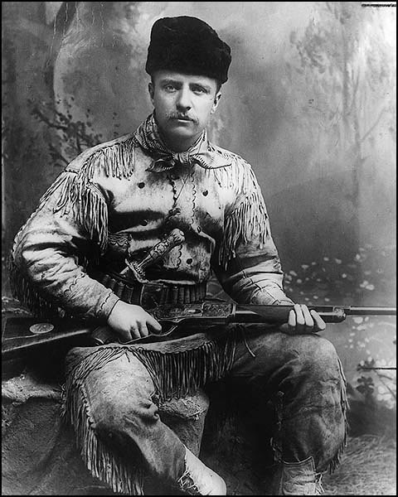
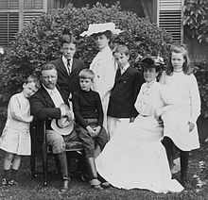
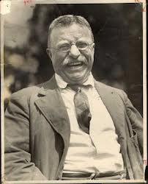
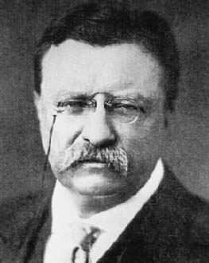
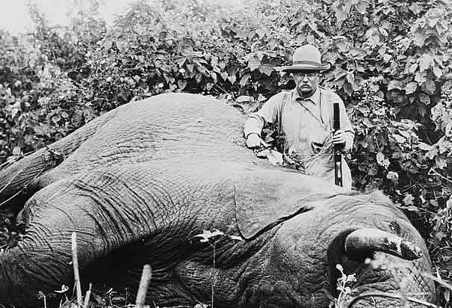
Roosevelt – A Man of many trades
Hunter & environmentalist
Cowboy & NY socialite
Loved individualism in business & fought to stop monopolies

Slide 10
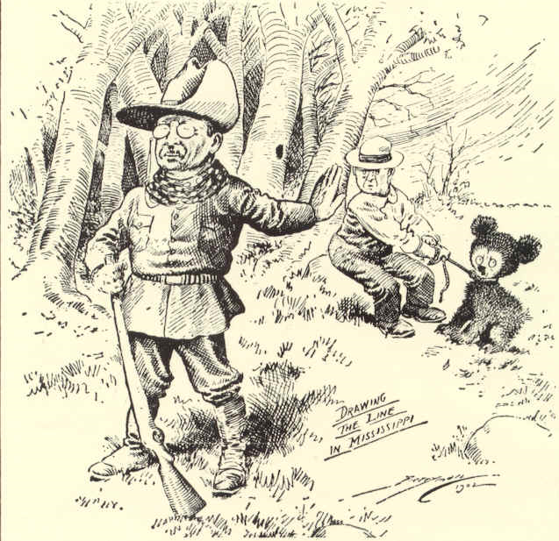
Did you know the ‘teddy bear’ is named after TR?
Washington Post cartoon - 1902

Slide 11
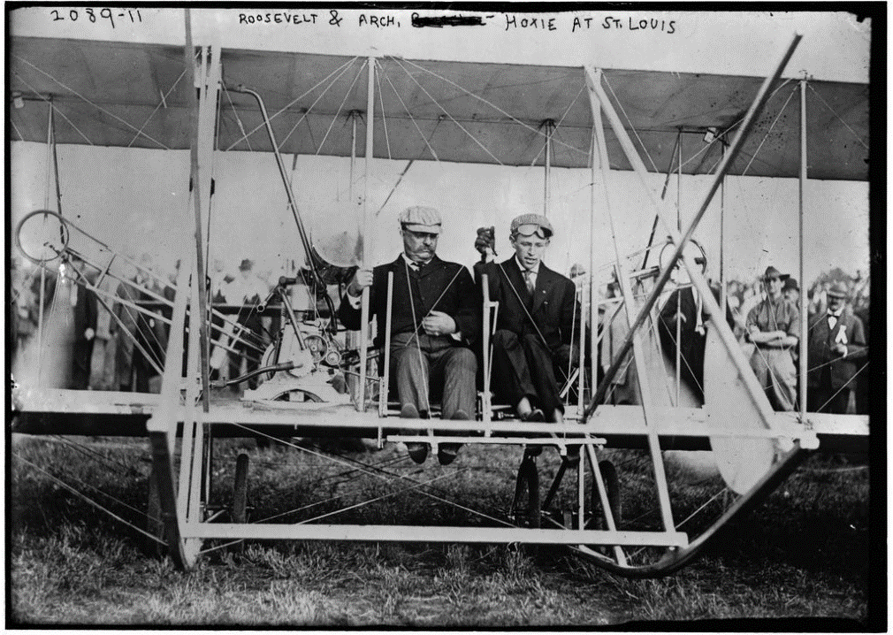
Theodore Roosevelt
Presidential firsts: ride in an automobile, fly in an airplane, dive in a submarine, & travel outside the US while in office
Assassination attempt in 1912: “I don’t know whether you fully understand that I have been shot, but it takes more than that to kill a Bull Moose”
Loved to travel: At 60 yrs. old, TR traveled to S. America. He contracted malaria and died from heart failure a few years later.

Slide 12
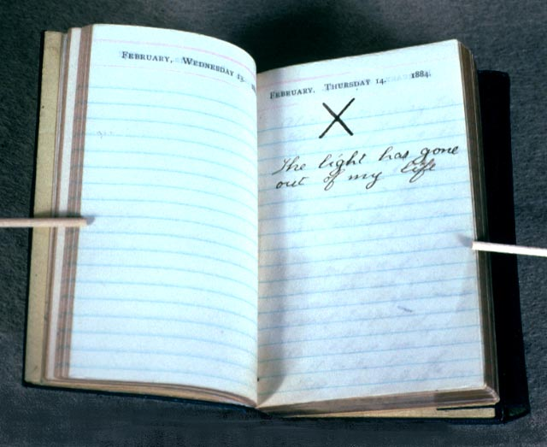

Slide 13
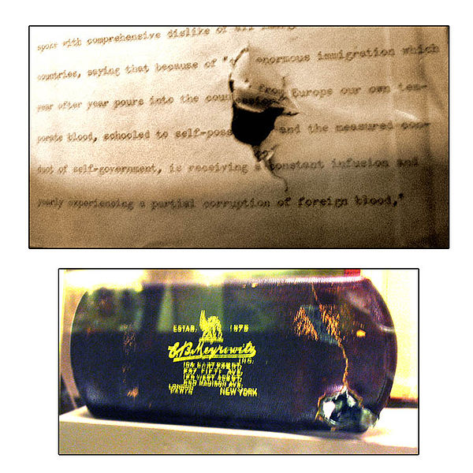

Slide 14
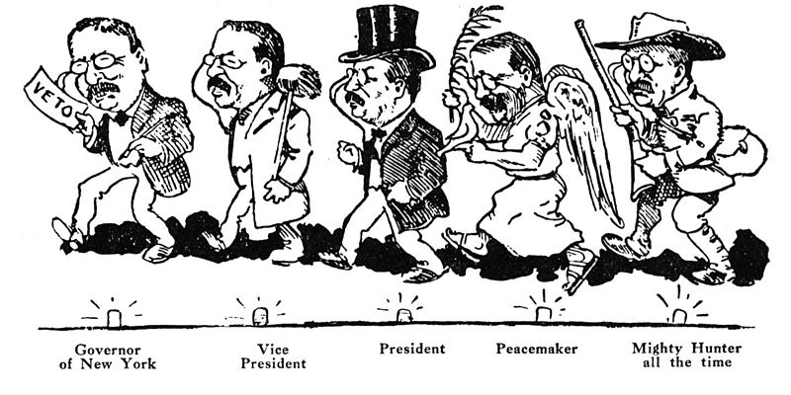

Slide 15
Roosevelt’s Big Stick Diplomacy
“Speak softly and carry a big stick; you will go far”
Central point: The U.S. government would intervene to prevent invasion from other powers.
Caused a lot of U.S. interventions in Latin America during the 20th century (Review → how was it used???)
To keep an open door trading policy with China he mediated a peace agreement between China, Russia and Japan, which ended the Russo-Japanese War. This won him a Nobel Peace Prize.
Other Roosevelt foreign policies:
Roosevelt Corollary
Extraterritoriality

Slide 16
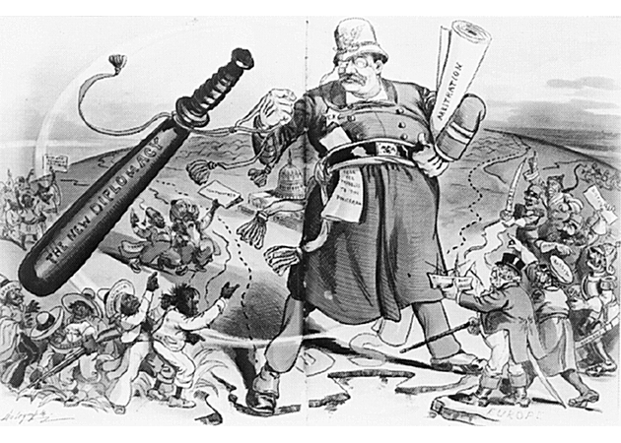

Slide 17
Discuss!
Strengths vs. Weaknesses

Slide 18
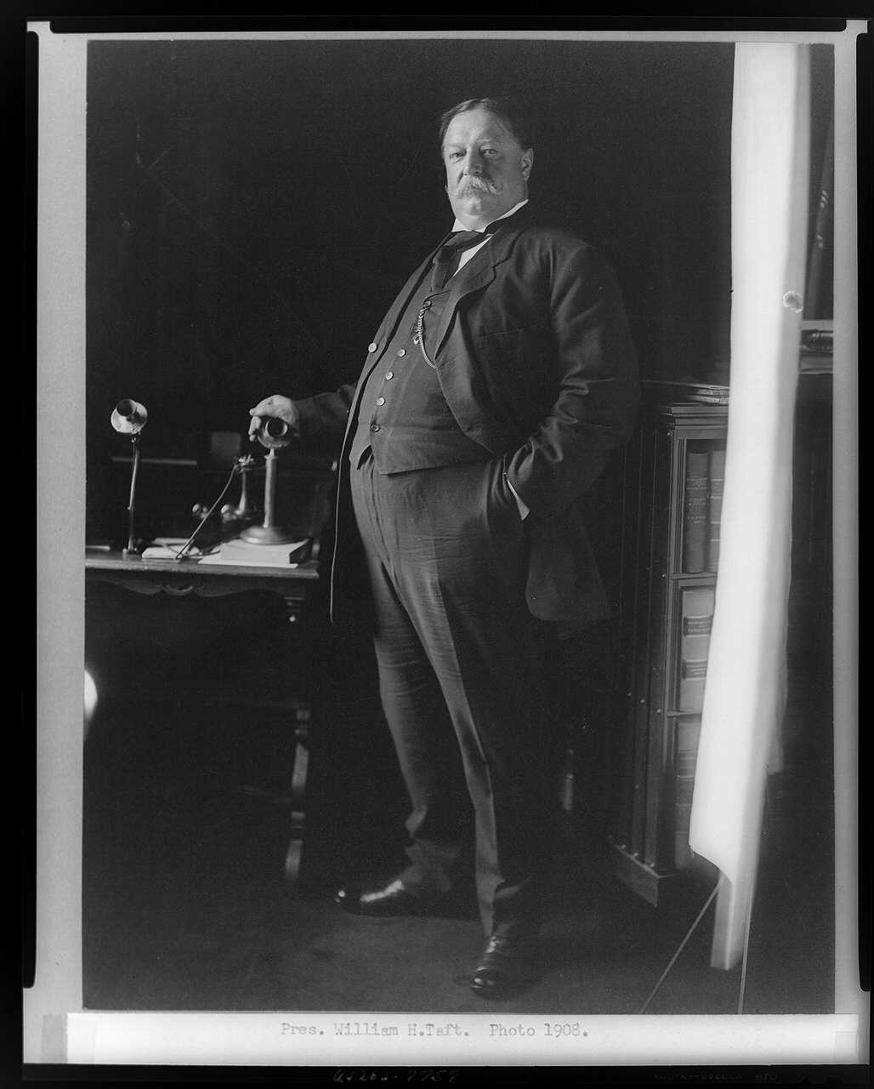
William Howard Taft FUN FACTS!
1909-1913
Nickname: “Big Bill”
Appointed by McKinley as Governor of Philippines
Personality: lethargic, unsure of himself, disliked speaking
Weighed 325 Pounds
Big Bill: Split his pants wile visiting the czar of Russia, couldn’t tie his own shoes, got stuck in the White House bathtub several times.

Slide 19
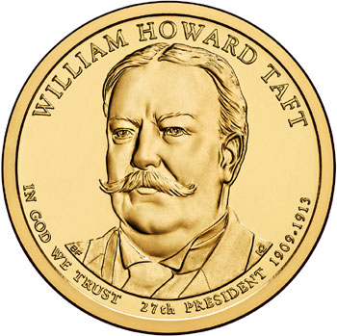
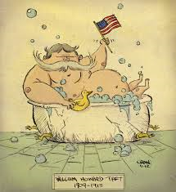
Taft’s Foreign Policy
Dollar Diplomacy: manage the affairs of “backwards” countries to ensure their debts were paid to European countries
Included loans from US banks, financial managers sent by US, training on efficient tax collection and help regulating their budget
Extended US business interests in Latin America (Review → how was it used???)

Slide 20
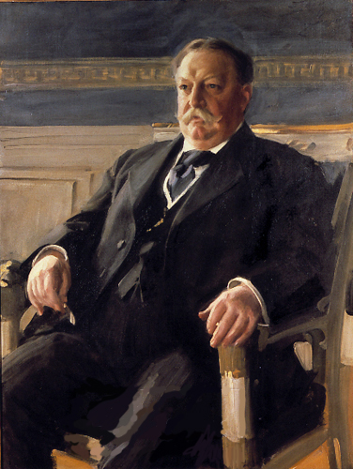
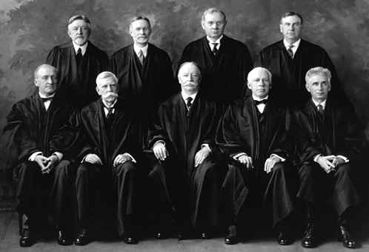

Slide 21
Discuss!
Strengths vs. Weaknesses

Slide 22
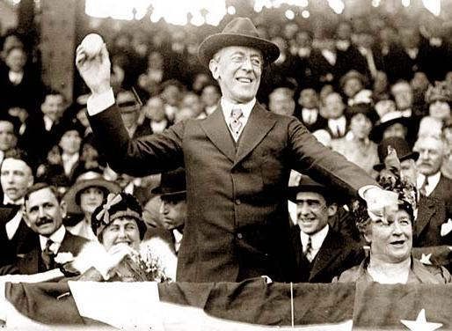
Woodrow Wilson FUN FACTS!
Nickname: “The School Master” because he was the best-educated President.
Despite his cold exterior, Wilson wrote 1,000’s of sexy love letters to his wife, and frequently visited a woman in Bermuda
In 1919 Wilson suffered a stroke, his wife Edith his replacement during his recovery (first female president?)

Slide 23
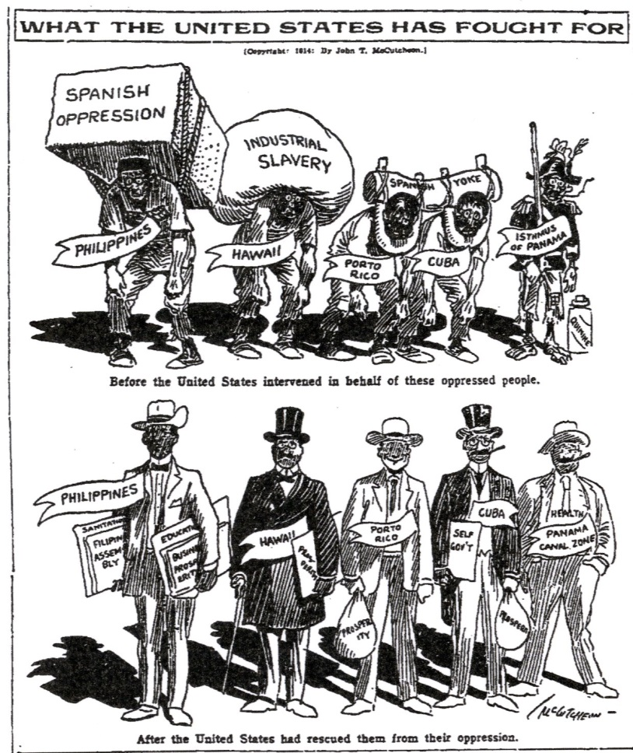
Wilson’s Foreign Policy
Moral Diplomacy: support is given only to countries to encourage and develop human rights
This promotes the growth of the nation's democratic/Christian ideals
Wilson hoped to increase the number of democratic nations, particularly in Latin America
(Review → how was it used???)

Slide 24
Discuss!
Strengths vs. Weaknesses

Slide 25
Review!
Similarities and differences between the three Progressive foreign policies.
Which one of the foreign policies do you think would be most effective in ridding Latin America of foreign influence? Least? Why?

Slide 26
Progressive Foreign Policy Project

