Slide 1
Warm-Up Discussion
How did the Japanese view surrender? Why?
THINKER: Look at the Japanese expansion map on page 623 – why were the Japanese able to seize the European colonies in this region so easily?

Slide 2
WWII in the Pacific
Japan – from aggression to surrender

Slide 3
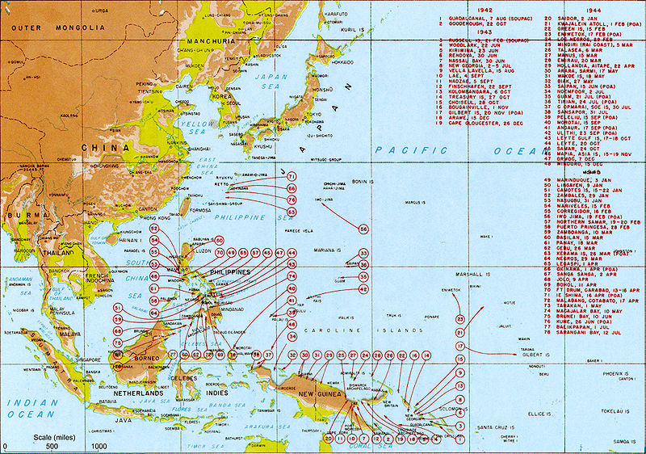
Intro to WWII in the Pacific
Japan forced soldiers from Korea, Thailand, Burma & India to fight for their army.
By 1945, several countries were aiding US efforts in the Pacific: Canada, Australia, China, Philippines, New Zealand and the Netherlands (b/c of Dutch East Indies)
USSR declares war on Japan in August 1945, and fights mostly inland battles in China against Japan

Slide 4
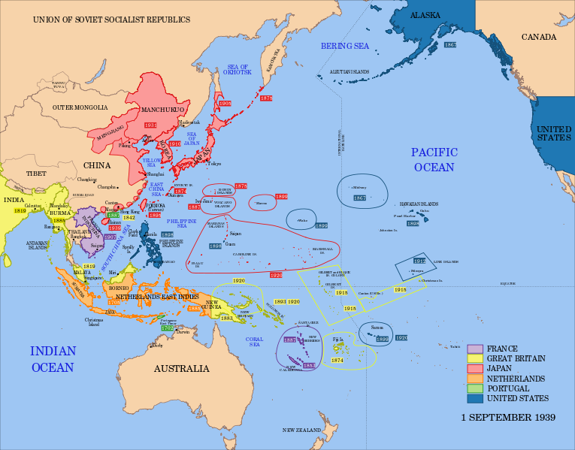

Slide 5
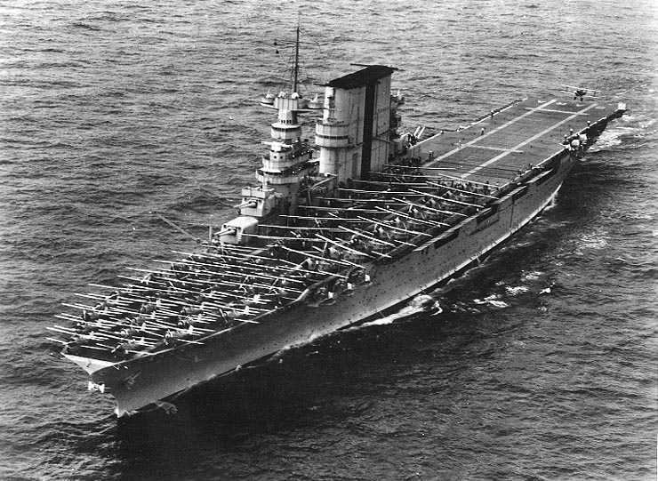
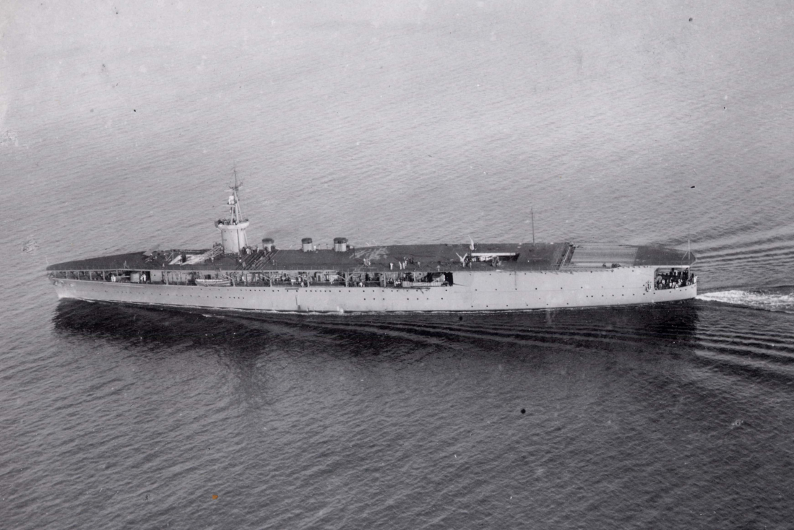
Why were aircraft carriers so vital to WWII in the Pacific?
USS Ticonderoga
Japanese Hosho

Slide 6
Japanese Offensives: 1941-1942
Japan attacks American and British military bases across the Western Pacific.
Rapid conquests of Hong Kong, Burma, New Guinea, India
Navy used kamikazes, or suicide planes
By mid-1942 it became difficult for Japan to maintain control of vast empire.

Slide 7
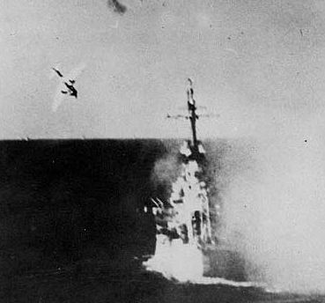
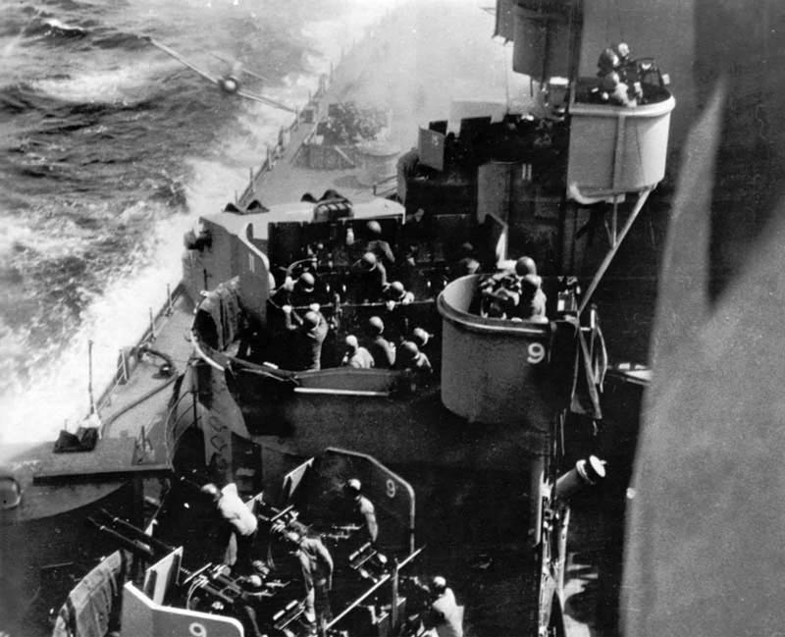
Kamikaze

Slide 8
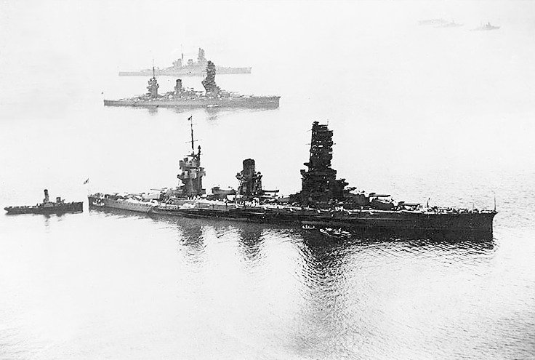
Japanese battleships Yamashiro, Fuso and Haruna

Slide 9
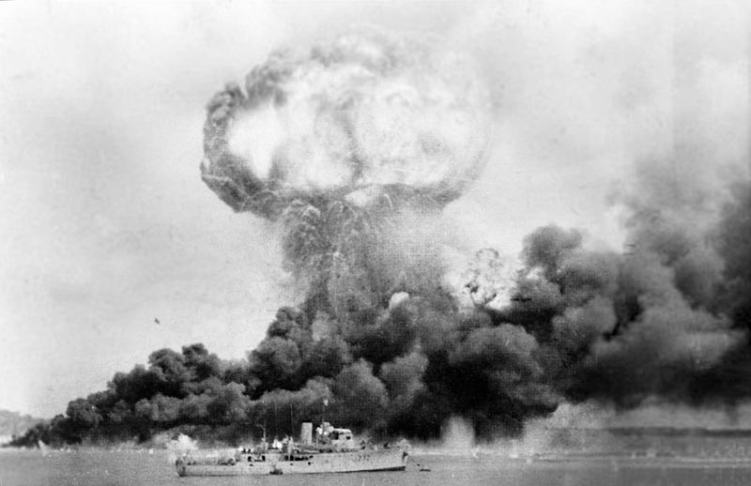
Bombing of Darwin, Australia; 1942

Slide 10
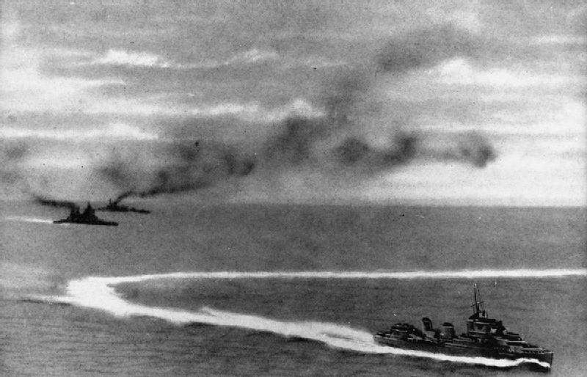
Prince of Wales (left, front) and Repulse (left, behind) under Japanese air attack on 10 December 1941 by a Japanese destroyer

Slide 11
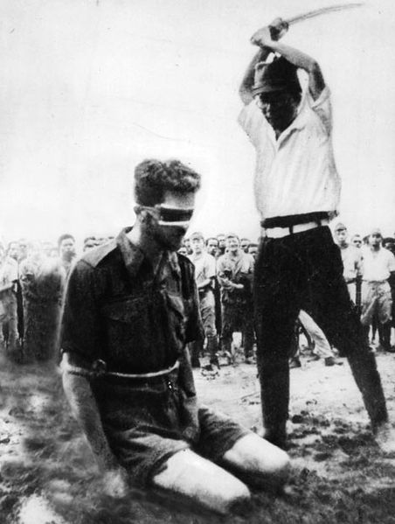
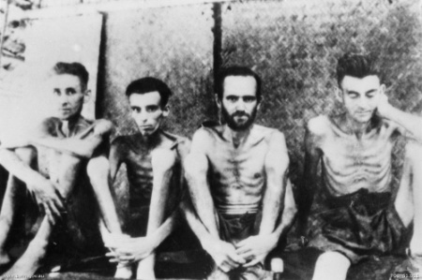
Australian POW’s; Total captured – 22,000

Slide 12
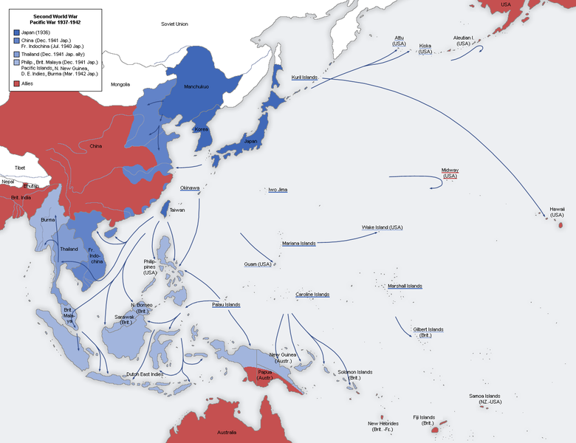

Slide 13
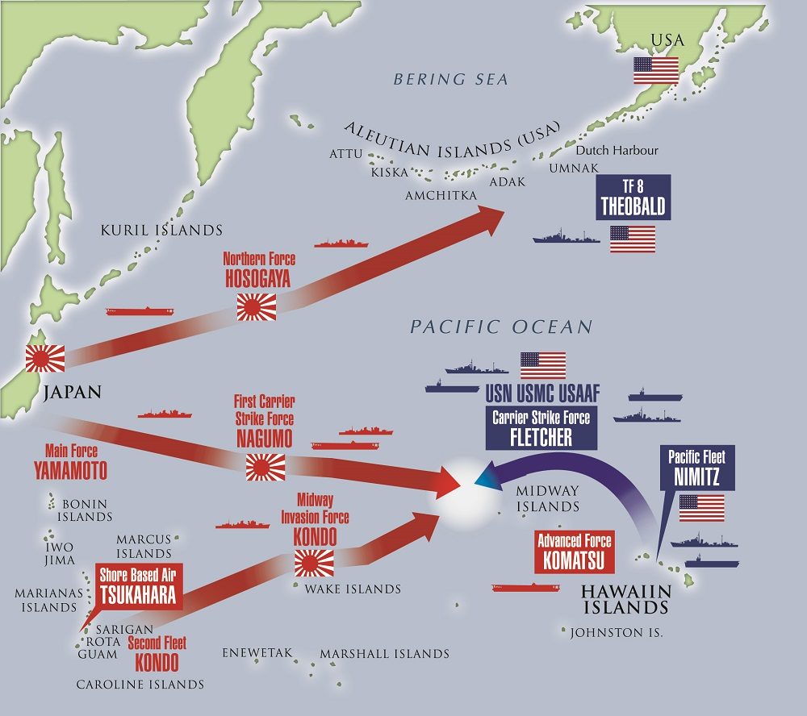
War in the Pacific: Turning Points
Battle of Midway: (6/4/1942) U.S. wins its first Pacific battle by fighting entirely from the air and destroying the Japanese navy (trap!)
Code talkers discovered several planned attacks
American forces began island hopping: a military strategy of attacking specific enemy-held islands.

Slide 14
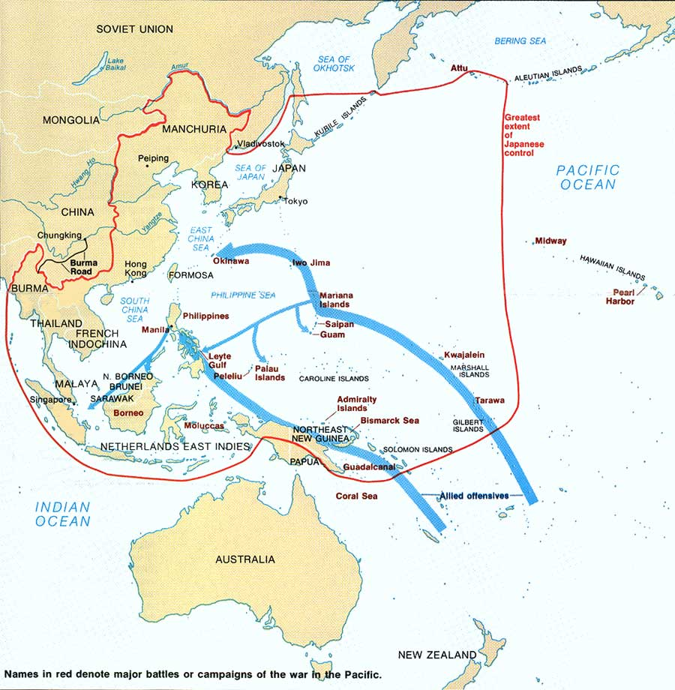

Slide 15
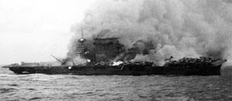
U.S. aircraft carrier, Lexington under attack in the Battle of the Coral Sea

Slide 16
Allied Offensives: 1943-1944
Battle of Guadalcanal: First Japanese-held territory conquered by the U.S. → huge drop in morale for Japanese
Battle of Leyte Gulf: Greatest naval battle in history; vital to stop oil production → destroys remainder of Japanese naval fleet
Battle of Iwo Jima: Japan is outnumbered, but dug-in to defenses; clear victory and morale boost for Allies
Battle of Okinawa: Last obstacle to an Allied invasion of the Japanese home islands → showed Allies what invasion of Japan would be like so…
  Began bombing campaign in Tokyo
  Decided to use the atomic bomb

Slide 17
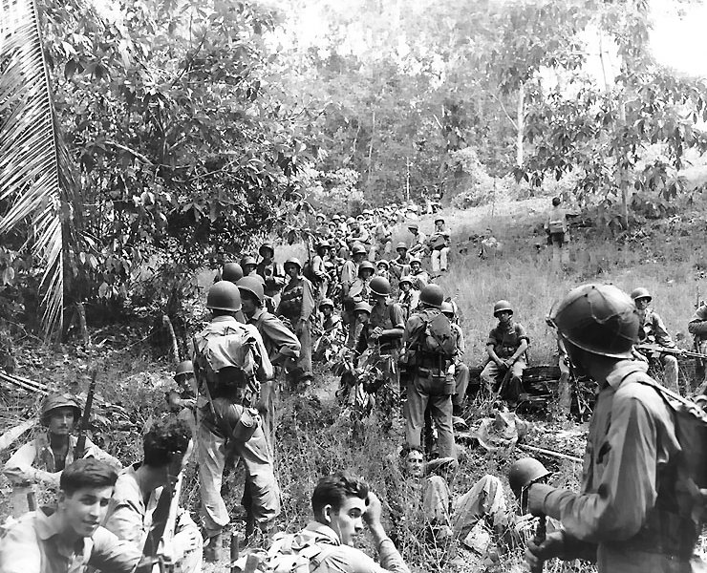
U.S. Marines in Guadalcanal; 1942

Slide 18
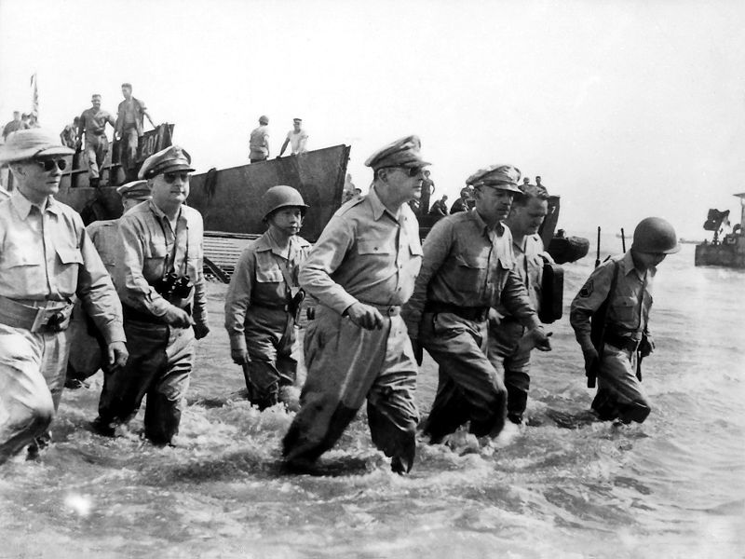
General MacArthur at Leyte Gulf

Slide 19
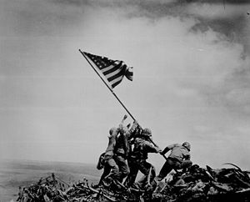

Slide 20
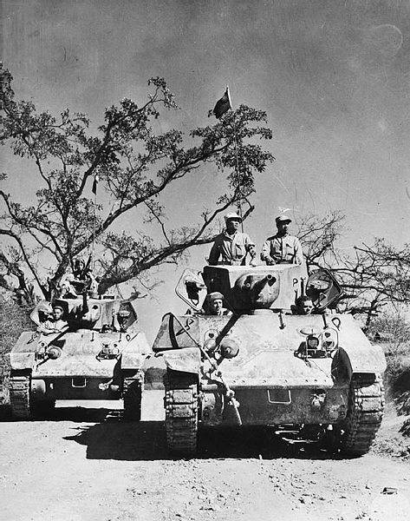
Chinese ground forces

Slide 21
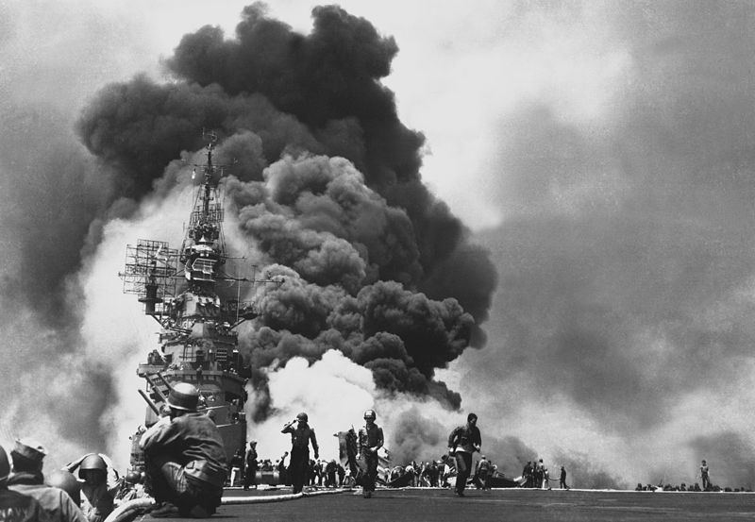
American ship, Bunker Hill, after being attacked by Kamikazes – Battle of Okinawa

Slide 23
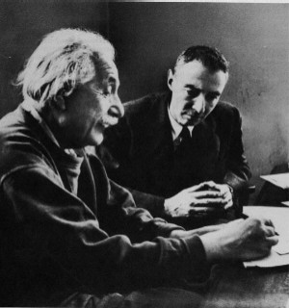
The Manhattan Project
A 1941 top secret plan to develop the first atomic bomb.
Combination of scientists and physicists
  Albert Einstein
  Robert Oppenheimer
Presidential approval
  FDR
  Truman

Slide 24
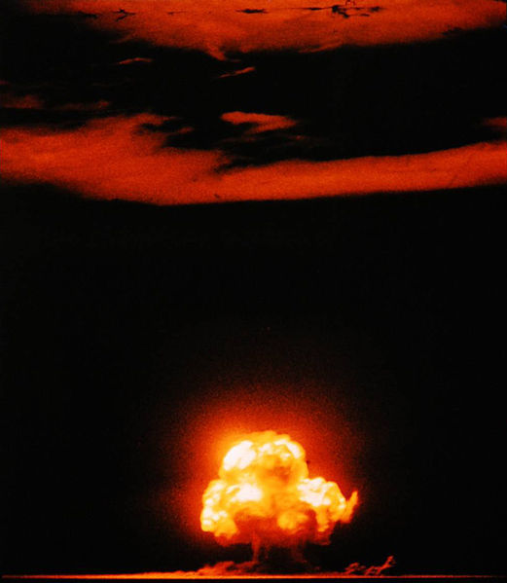
Atomic bomb test: Los Alamos, New Mexico – July 1945

Slide 25
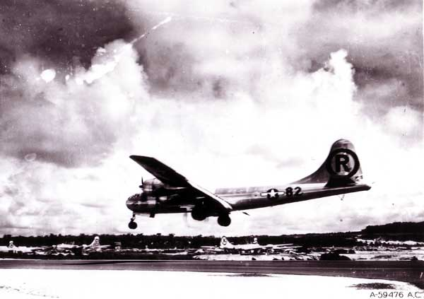
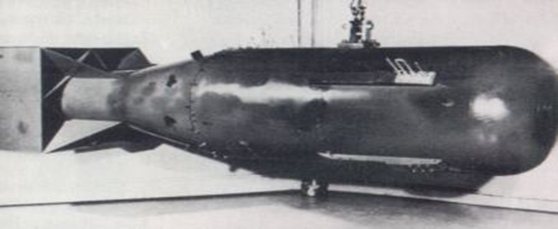
Atomic Bombing of Hiroshima
The first atomic bomb was dropped on Hiroshima on August 6, 1945

Slide 26
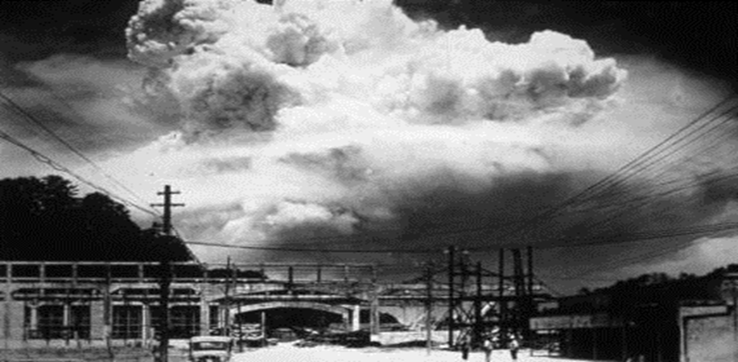
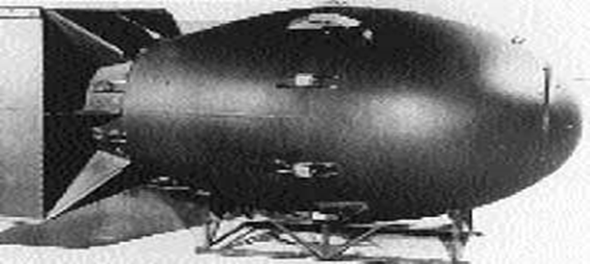
Atomic Bombing of Nagasaki
The second atomic bomb was dropped on Nagasaki August 9, 1945

Slide 27
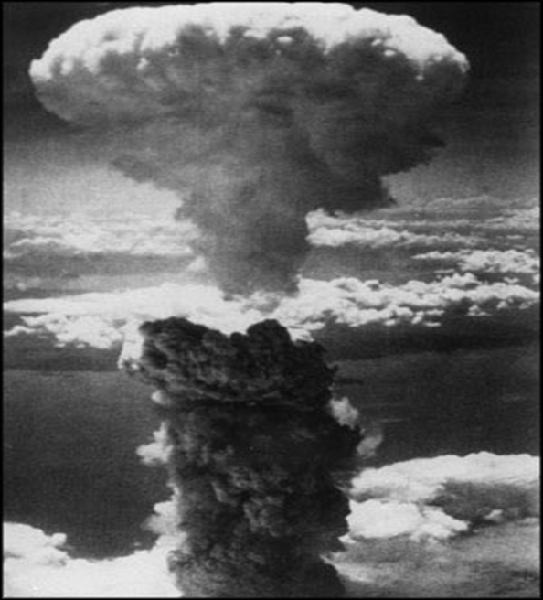
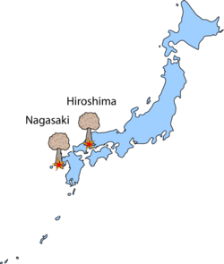
Hiroshima and Nagasaki

Slide 28
The day the bomb was dropped…
https://www.youtube.com/watch?v=NF4LQaWJRDg

Slide 29
Aftermath
Ground Temperature | 7000F
Force Winds | 980mph
Energy Released | 20,000 tons of TNT
Buildings Destroyed | 62,000
Killed Immediately | 80,000 people
Dead by end of 1945 | 140,000 people
Total Deaths | 220,000 people

Slide 30
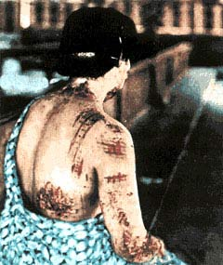
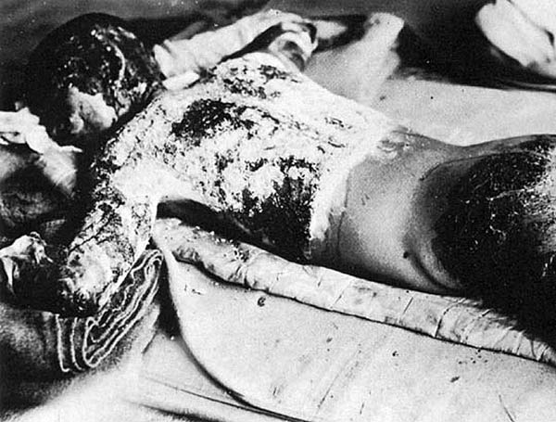

Slide 31
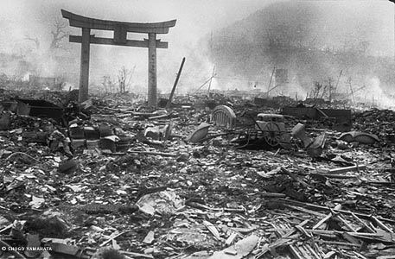
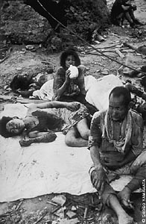
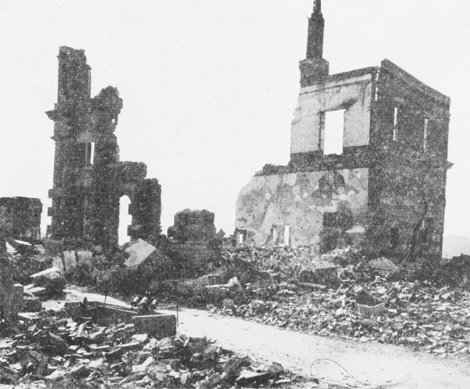

Slide 32
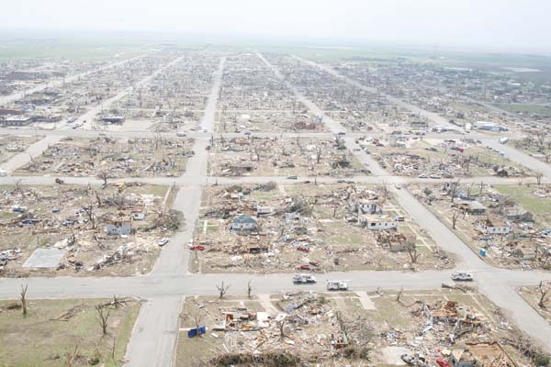

Slide 33
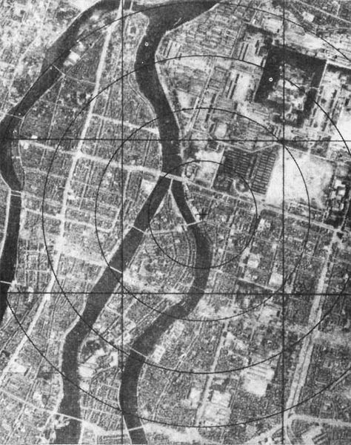
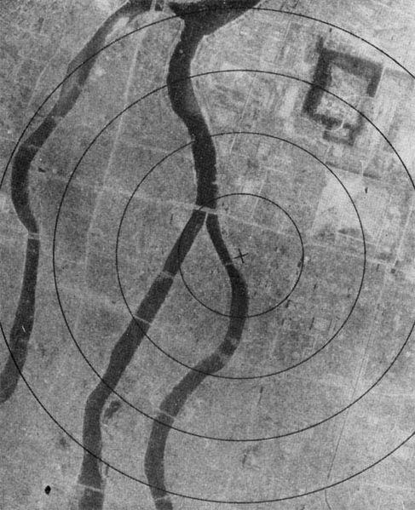
Hiroshima

Slide 34
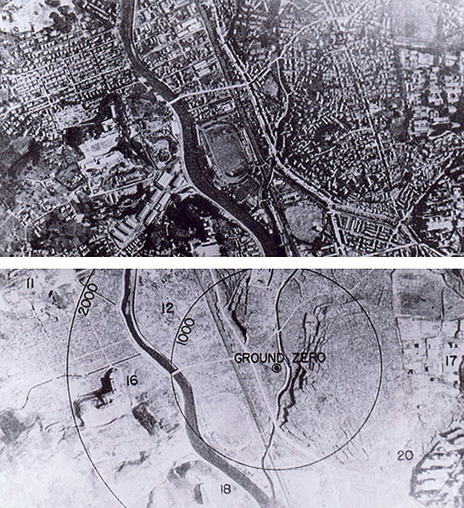
Nagasaki

Slide 35
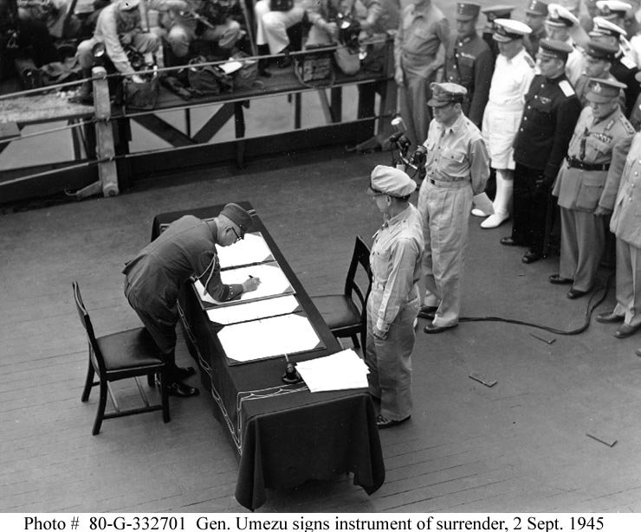
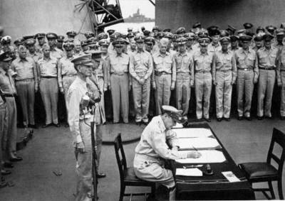
Surrender
Japan surrendered to General Douglas MacArthur on September 2, 1945

Slide 36
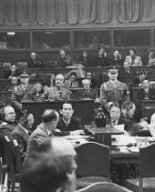
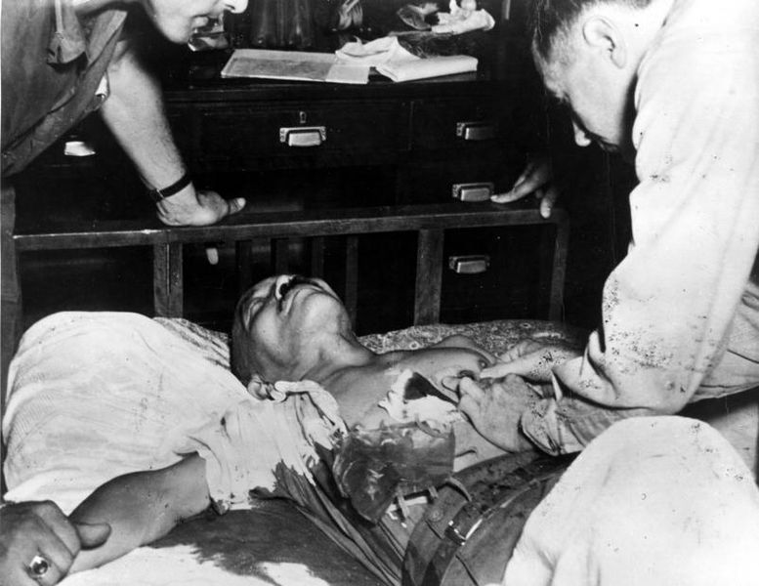
Hideki Tojo
Found guilty of war crimes & sentenced to death!
“War Crimes” included…..
Unfair treatment of POW’s
Crimes against humanity (rape)
Killing of innocent civilians

Slide 37
WWII Outcomes
Europe
Pacific
Germany is divided into four, each occupied by a larger power
Stalin obtained Poland
UN is created
Germany pays reparations to Soviet Union
War Crime Trials
Denazification
Allied occupation of Japan
Removal of Japanese troops in China
Territories are reclaimed: Taiwan, Korea (divided), Pacific Islands
Maintained by UN, but under leadership of US General, Douglas MacArthur
USSR gets control of Pacific Islands

Slide 38
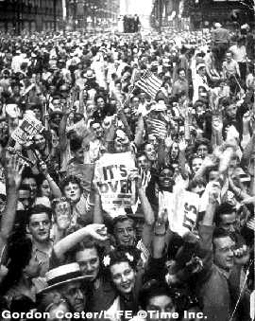
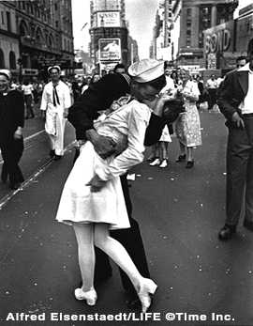
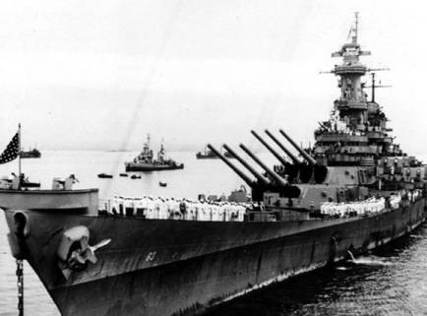
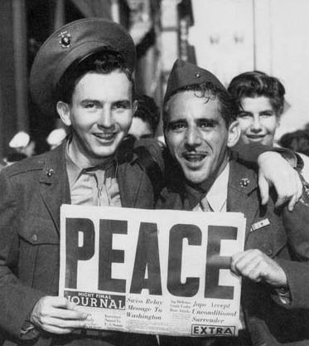
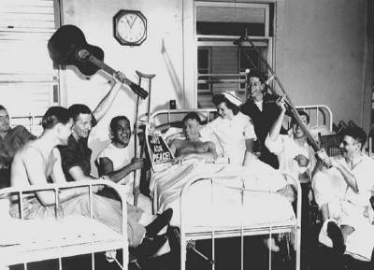
End of
WWII

Slide 39
Effects of WWII
70 million soldiers fought in WWII
55 million died
Soviet Union – 22 million
Germany – 8 million
Japan – 2 million
United States – 300,000
In addition to casualties, many areas of Europe and Asia laid in ruins
Use of deadly weapons and fighting tactics made WWII the most destructive war in history!

Slide 40
OLD BELLWORK!
At the war conferences, what was decided with regards to the future of Germany?
What decisions were reached with control of Eastern Europe? Why?
What conflicts between the powers existed at the war conferences?
How did the Japanese view surrender? Why?
THINKER: Look at the Japanese expansion map on page 623 – why were the Japanese able to seize the European colonies in this region so easily?

Slide 41
Following slides were removed to save time, but add in review clips next year!

Slide 42
War in the Pacific: Turning Points
Battle of Midway: (6/4/1942) U.S. wins its first Pacific battle by fighting entirely from the air and destroying the Japanese navy (trap!)
Code talkers discovered several planned attacks
American forces began island hopping: a military strategy of attacking specific enemy-held islands.
https://www.youtube.com/watch?v=sKXVTZo6gIg

Slide 43
Allied Offensives: 1943-1944
Battle of Guadalcanal: First Japanese-held territory conquered by the U.S. → huge drop in morale for Japanese
Battle of Leyte Gulf: Greatest naval battle in history; vital to stop oil production → destroys remainder of Japanese naval fleet
Battle of Iwo Jima: Japan is outnumbered; clear victory and morale boost for Allies
  https://www.youtube.com/watch?v=5Y0gdFisD9k
Battle of Okinawa: Last obstacle to an Allied invasion of the Japanese home islands → showed Allies what invasion of Japan would be like so…
  Began bombing campaign in Tokyo
  Decided to use the atomic bomb
  https://www.youtube.com/watch?v=v3Lbv0K8gCs

Slide 44
Discussion
Was the atomic bomb the right thing to do?
In your notes, divide the paper in ½.
In one column, list pro arguments.
In the other column, list anti arguments.
Come up with at least four arguments for each side!
Be ready to discuss!

Slide 45
Civilian Warnings Pre-Hiroshima
TO THE JAPANESE PEOPLE:
America asks that you take immediate heed of what we say on this leaflet.
We are in possession of the most destructive explosive ever devised by man. A single one of our newly developed atomic bombs is actually the equivalent in explosive power to what 2000 of our giant B-29s can carry on a single mission. This awful fact is one for you to ponder and we solemnly assure you it is grimly accurate.
We urge that you accept these consequences and begin the work of building a new, better and peace-loving Japan.
You should take steps now to cease military resistance. Otherwise, we shall resolutely employ this bomb and all our other superior weapons to promptly and forcefully end the war.

Slide 46
Civilian Warning Pre-Nagasaki
ATTENTION JAPANESE PEOPLE. EVACUATE YOUR CITIES.
Because your military leaders have rejected the thirteen part surrender declaration, two momentous events have occurred in the last few days.
The Soviet Union, because of this rejection on the part of the military has notified your Ambassador Sato that it has declared war on your nation. Thus, all powerful countries of the world are now at war with you.
Also, because of your leaders' refusal to accept the surrender declaration that would enable Japan to honorably end this useless war, we have employed our atomic bomb.
Hiroshima was virtually destroyed.
Before we use this bomb again and again to destroy every resource of the military by which they are prolonging this useless war, petition the emperor now to end the war. Our president has outlined for you the thirteen consequences of an honorable surrender. We urge that you accept these consequences and begin the work of building a new, better, and peace-loving Japan.
Act at once or we shall resolutely employ this bomb and all our other superior weapons to promptly and forcefully end the war.
EVACUATE YOUR CITIES.

Slide 47
What do YOU think? Was dropping the atomic bomb the right thing to do?
PRO BOMB!
ANTI BOMB!

