Slide 1
Socialism in America
Presented by: Adiella Cotapike, Etienne Weigreyniak, and Yoshie Wingate

Slide 2
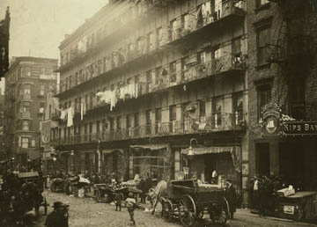
U.S. Problems leading to people to choose socialism
Americans faced large amounts of unsafe working conditions, as well as unfair pay.
Immigrants also face discrimination as well as having limited rights, and completely unhealthy living conditions.
The streets were completely filthy with the streets being cramped and filled with people.
Diseases as well as poor health conditions, in housing, factories, and in food industry.

Slide 3
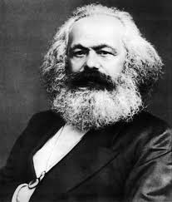
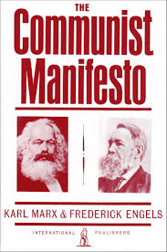
Karl Marx and The Communist Manifesto
Karl Marx was born on May 5 1818 and died March 1883
Created the Communist Manifesto a written Pamphlet of how the working class would rise up against the social elite.
It was published in February of 1848 in 46 Liverpool in the the street of London.
Within forty years a large portion of the world adopted the socialist labour parties, but none of them chose the Communist Party as their name until the Russian Bolsheviks.
The Communist Manifesto was well received by German immigrants and was later brought to the United States by German immigrants.

Slide 4
“The ‘dangerous class’, the social scum, that passively rotting mass thrown off by the lowest layers of old society, may, here and there, be swept into the movement by a proletarian revolution.”
“...in America as in Germany, [it] has stripped him of every trace of national character.”

Slide 5
Marxism For and Against
The revolutionary core of Marxism has obvious ramifications with the previous question of marxism as political reality.
The legacy of Marx is the magisterial figure from whom we must all learn if we are to carry on the task of critical inquiry that he began.

Slide 6
Beginning of American Socialism
Socialism is the practice of being a community, where production, distribution, and exchange is regulated as a whole
In 1825, Robert Owen’s Utopian Communities began the uprising of socialist ideas
From 1857-1888, the large amount of German Immigrants brought Social Democracy to America
The books “The Cooperative Commonwealth” by Laurence Gronlund and “Looking Backward” in 1988-1897, started to create 20th century American socialist beliefs

Slide 7
Robert Owen
Born in 1771 in Newton, Montgomeryshire, Wales, Robert Owen was a British socialist in the 1790’s
Wanted to introduce “principles in the conduct of the people” and rejected the competitive business system because these had to do with character formation
Believed in “one man’s gain” would not be “another man’s loss” and also thought that a healthy, happy environment would shape individual character along the right social lines
Wanted to not only educate children, but adults as well

Slide 8
American Socialism in the Early 1900’s
From 1897-1900s, the Social Democracy of America and Socialist Labor party form from Eugene Debs
Socialist parties were apart of the Progressive Era; where corruption in the government was trying to be reversed and began with the election of the 26th president, Theodore Roosevelt in 1901
Upton Sinclair founded the Intercollegiate Socialist Society which its purpose was to spread the cause of socialism in 1905

Slide 9
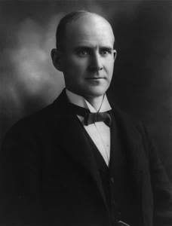
Eugene Debs
Born in 1855, Eugene V. Debs was a labor organizer and the Socialist Party’s candidate for U.S president five times between 1900-1920 His union conducted a successful strike for higher wages against the Great Northern Railway in 1894 and became president for the American Railway Union the year before Went to jail for leading the Chicago Pullman Palace Car Company Strike and became renown after that

Slide 10
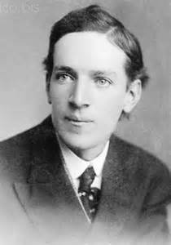
Upton Sinclair
Upton Sinclair was born in Maryland in 1878 and became known for His involvement in socialism with the best-selling novel The Jungle (1906) Sinclair stated that, “the ideals of America stressed equality and brotherhood, but in all actuality, the rich did indeed get richer and the poor got poorer. No equality. No brotherhood” Many people aren’t able to separate politics with the economic system, and The Jungle was seen as an attack on the meatpacking industry Sinclair’s goal was to attain what he called the “democratic socialism” in the US

Slide 11
The Downfall of Socialism
The election of 1912 made the socialist party lose thousands of members due to many voting for Woodrow Wilson, who presented more “progressive” ideas rather than their own party
By 1920, The United States passed the Espionage Act and Sedition Act of 1918 which jailed those who were “unloyal” to the U.S. by not supporting WW1. Socialists believed going to war was of capitalist interests therefore they did not support U.S. involvement in war
The Red Scare was started by socialist/communist strikes and the fear of fascism in the United States. Any suspected socialist or communist individuals were thrown in prison.

Slide 12
Effects of Early 20th Century American Socialism
Socialism in the 1900’s led to the modern National Socialist Movement whose goal is to purify Americans by (non)violence
They reject democracy and human rights because they believe there are times that the individual must be spared for the community
These individuals are also known as Neo-Nazis, Antisemitics, or Fascists
This party shares a love for Adolf Hitler and a hate for Jews and other minorities such as LGBTQ and sometimes Christians. They believe in similar ideas that Nazis held in the 1930s and 1940s.
The Socialist Party USA believes in Democratic Socialism
Equality everywhere so everyone can live in harmony together
Rights for women, cultural freedom, self-governed individuals
Distribution of goods should be controlled by the public

Slide 13
Works Cited
Davenport, Tim. "INTERCOLLEGIATE SOCIALIST SOCIETY (1905-1921) Organizational History." INTERCOLLEGIATE SOCIALIST SOCIETY (1905-1921) Organizational History. Early American Socialism, n.d. Web. 31 Jan. 2017.
"Socialism in America." Socialism in America. Online HIghways, n.d. Web. 30 Jan. 2017.
Haute, Terre. A Brief History of Socialism in America. N.p.: Debs, n.d. Socialist Party of America. Marxist.org. Web. 30 Jan. 2017. <https://www.marxists.org/history/usa/parties/spusa/1900/0100-sdp-briefhistorysoc.pdf>.
Kreis, Steven. "Robert Owen, 1771-1858." Historyguide.org. The History Guide, 13 May 2004. Web. 31 Jan. 2017.
History.com Staff. "Eugene V. Debs." History.com. A&E Television Networks, 2009. Web. 31 Jan. 2017.
"Upton Sinclair." Biography.com. A&E Networks Television, 07 Aug. 2015. Web. 31 Jan. 2017.
Hickman, Kennedy. "Woodrow Wilson's Fourteen Points: A Path to Peace." About.com Education. About Education, 29 Aug. 2016. Web. 31 Jan. 2017
"Principles." Socialist Party USA. Socialist Party USA, n.d. Web. 31 Jan. 2017.
Robert L. Heilbroner. Marxism For and Against. George J. McLeod Limited, Toronto Canada, p.60 and p.45
Eric Hobsbawm. The Communist Manifesto, A Modern Edition. Verso 1998. Eric Hobsbawm, English 1848 180 Varick Street, New York NY.

